Slide 1

Mallareddy Engineering College
(An UGC Autonomous Institution Approved by AICTE, New Delhi & Affiliated to JNTUH ,Hyderabad).
Accredited by NAAC with ‘A++’ Grade(Cycle-III) , Maisammaguda(H),Medchal – Malkajgiri District, Secunderabad,Telangana State -500100 , www.mrec.ac.in
Title : Text to Speech Convertor using Python
BY
21J41A67E6 | CH. SOWMYA
21J41A67F3 | G. VARUN
21J41A67J3 | R. ROHIT
21J41A67J5 | S. SRI CHARITHA
Guide : T. LAVANYA
DATASCIENCE - C

Slide 2
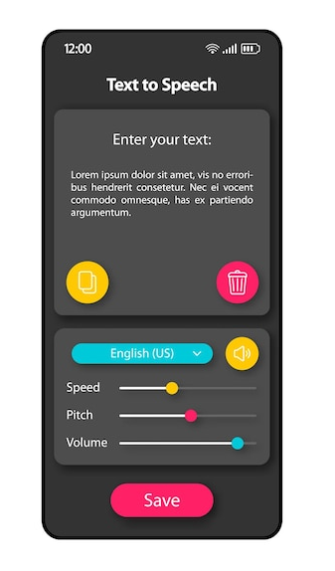

Text to Speech Convertor Using Python
This presentation explains a project that converts text into speech.
Users can enter the text in the input area, select a voice tone, and adjust the speech speed as needed.

Slide 3
Agenda
1
Introduction
2
Objective
3
Existing System
5
Modules
4
Proposed System
6
Architecture
7
Algorithms
Conclusion
9
Future Enhancement
8

Slide 4
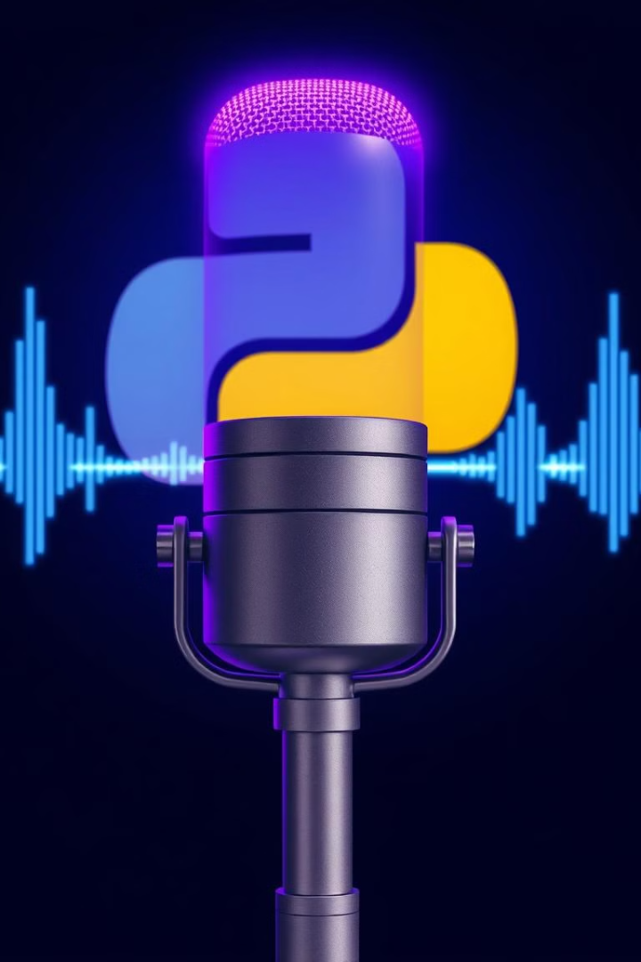
Introduction:
Text-to-speech (TTS) conversion is an interesting field of Natural Language Processing (NLP) that has numerous applications.
In this project, we aim to build a simple TTS converter using Python, In we will use the pyttsx3 module which provides a platform-independent interface for converting text to speech.
With pyttsx3, we can customize the voice, rate, and volume of the speech output, making it a flexible solution for a wide range of applications.
This project is an excellent opportunity for beginners to practice their Python skills while exploring the exciting world of TTS conversion.

Slide 5
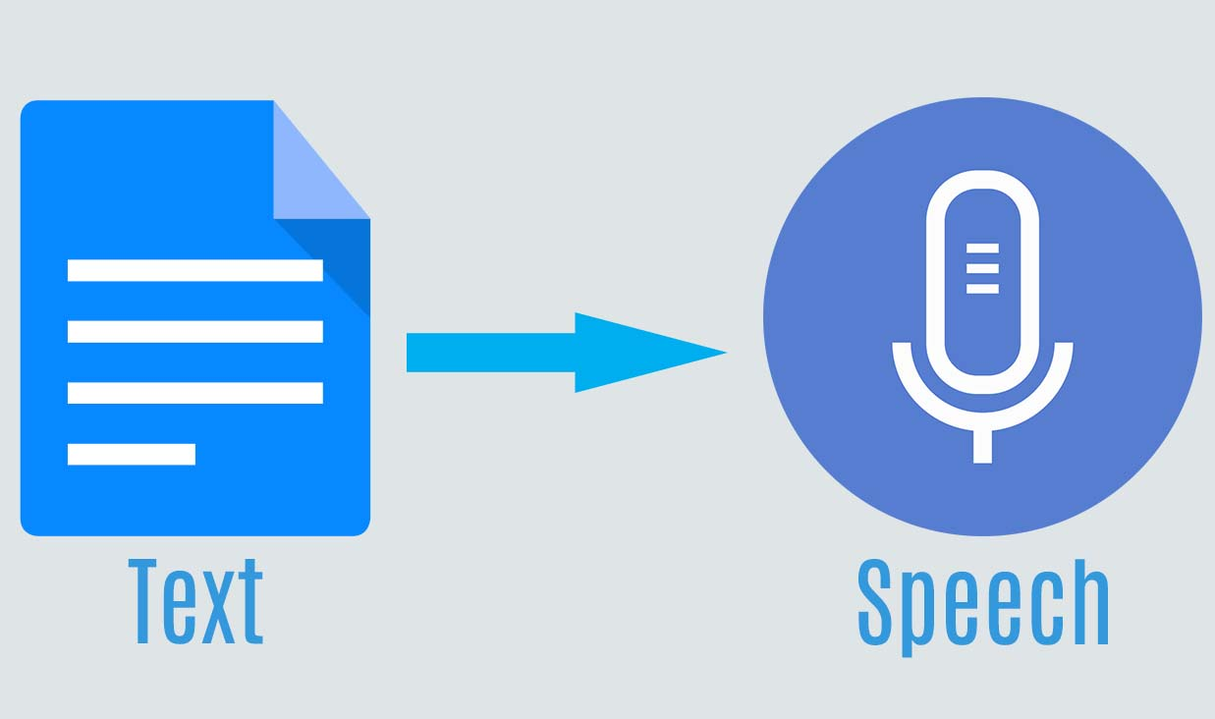
Objective of the Project
This Python project aims to build a Text-to-Speech (TTS) converter using the pyttsx3 module. The project provides a platform-independent interface for converting text to speech and allows users to customize the voice, rate, and volume of the output.
This project is an excellent learning opportunity for beginners to gain practical experience with Python and explore the exciting field of TTS conversion.
By implementing this project, users can develop a deeper understanding of NLP and its applications.
The pyttsx3-based Text-to-Speech (TTS) converter Python project provides a user-friendly interface for generating speech output from any text input.
The project can be customized to suit the user's needs, including voice, rate, and volume.

Slide 6
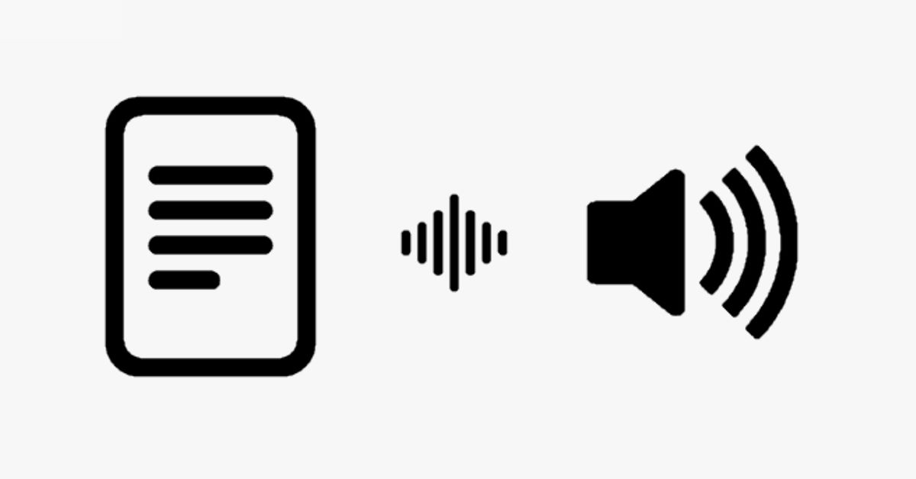
EXISTING SYSTEM:
• The Text-to-Speech may have usage limits or require payment for high volume usage.
• Text-to-speech software cannot convey emotion as well as a human voice can, which can be a problem.
• The resulting speech may have mispronunciations, especially for uncommon words or names.
• The system may not be suitable for real-time applications that require low latency or high accuracy, such as live captioning or translation.
• The synthesized speech may lack appropriate pauses, intonation, and emphasis, making it difficult to understand or follow

Slide 7
PROPOSED SYSTEM:
The proposed system will provide a user-friendly and accessible way to convert text to speech
with a button click or finger touch.
Text to speech conversion can help in reading large paragraphs and offers a range of different accents and voices.
Users will be able to adjust the speech speed, pitch, and other parameters to suit their preferences and needs.
Text to speech conversion can be used in vocal monitoring systems for blind people, web browsers, mobile phones, and PCs
The system can be used for a variety of applications, such as creating audiobooks, enhancing
accessibility features, or improving user experiences in virtual assistants or chatbots.

Slide 8
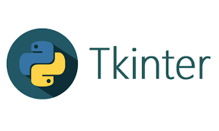
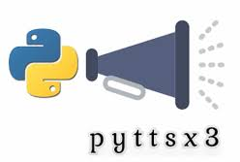
MODULES
• Tkinter: is a standard Python library used for creating graphical user interfaces (GUIs).
• Message box: it is a submodule of Tkinter that provides a set of predefined dialog boxes that can be used for displaying messages to the user.
• Pyttsx3: it is a Python library for text-to-speech conversion. It provides an application programming interface (API) for converting written text to speech audio.
• Filedialog: This module provides an easy-to-use interface for opening, saving, and selecting files and directories, which is useful when working with files in Python.

Slide 9
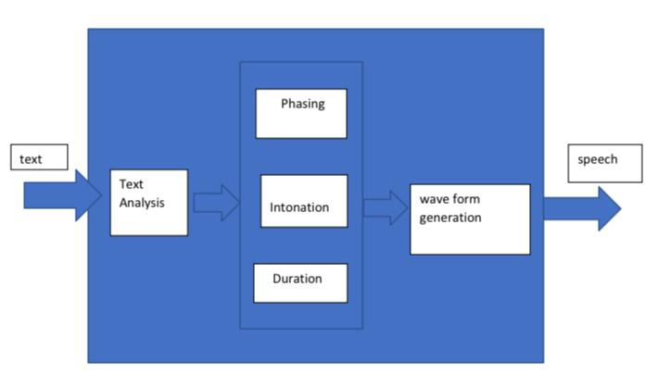
Architecture of the Project

Slide 10
In this architecture, the client component represents the user or application that needs to convert text to speech.
The text-to-speech conversion component processes the text input and generates the corresponding speech output using a TTS engine, such as one of the ones mentioned in the previous answer.
The audio output is then played back through the speaker component, which could be the computer's built-in speakers or an external audio device.
This architecture diagram shows a simple one-way flow of data from the client to the text-to-speech conversion component, and then to the speaker.
However, depending on the specific requirements, the architecture could be more complex and involve additional components, such as speech recognition for user input, a database for storing and retrieving text and speech data, or a web interface for remote access.

Slide 11
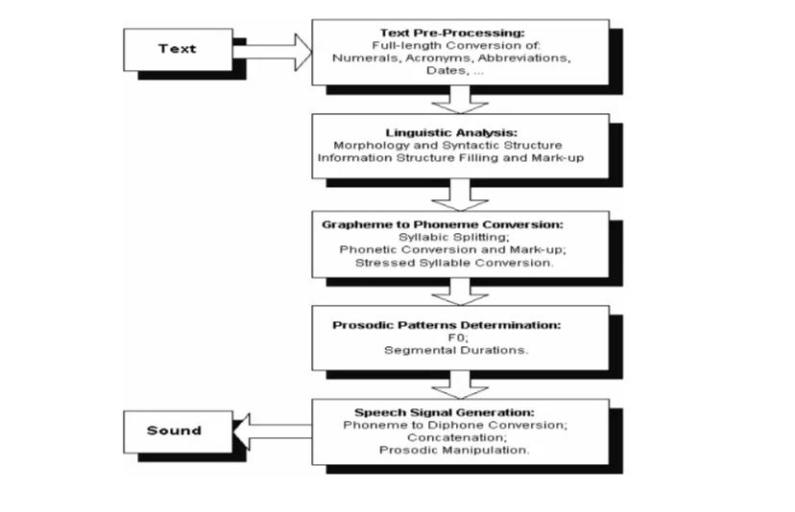
E-R Diagram:
Case Diagram:
A use case diagram would show the actors and use cases involved in the text-to-speech conversion system. Actors might include the user, the speech engine, and the text input source. Use cases might include "Convert text to speech" and "Adjust speech settings."

Slide 12
Algorithms & Methods
VOICE SELECTION ALGORITHM :
The code selects a voice based on gender (Male/Female) by choosing the corresponding voice ID from e.getProperty('voices')
SPEECH SYNTHESIS ALGORITHM:
pyttsx3 uses SAPI5 (Windows) or NSSpeechSynthesizer (MacOS) or espeak (Linux) as the backend
SPEED CONTROL ALGORITHM :
e.setProperty('rate', 300 if speed == 'Fast' else 150 if speed == 'Normal' else 50)
Indirectly Used NLP
Natural Language Processing (NLP) techniques in the speech synthesis engines:
Text Tokenization :
TTS breaks input text into words and phonemes before synthesizing speech.
2.Phoneme Conversion :
Converts text to phonemes (smallest speech units) for smooth pronunciation.
3. Prosody Control :
Adjusts speech rhythm, pitch, and intonation for natural-sounding speech.

Slide 13
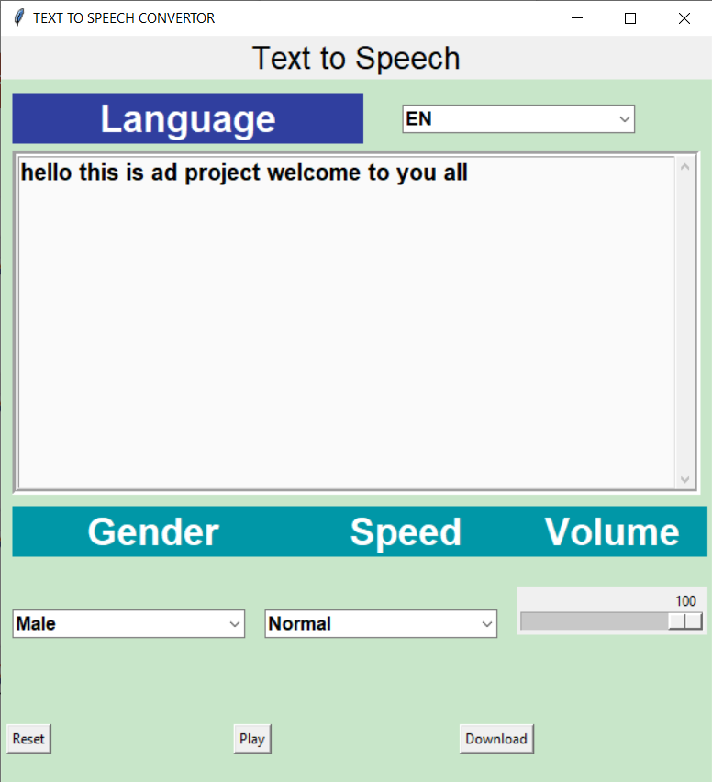
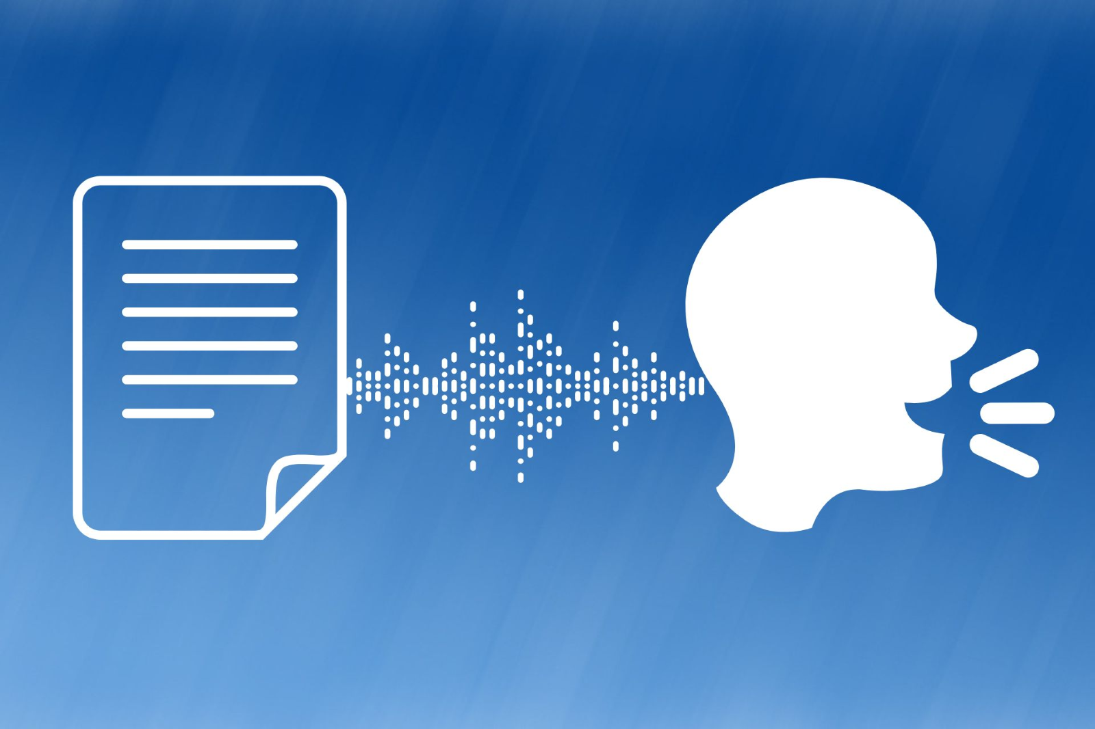
Implementation

Slide 14
Conclusion:
In conclusion, the text to speech converter project has been successfully completed, and it has provided an effective and user-friendly tool for converting text into speech.
The project aimed to provide a solution for people who have difficulty reading or who prefer listening to text instead of reading it.
The project has achieved its goals by using the Pyttsx3 library to convert the text to speech and providing a simple and intuitive user interface.
Overall, the project has been a success and could be further developed with additional features such as language translation and voice customization.

Slide 15
Future Enhancements:
Multi-Language Support: Adding support for multiple languages to enable users to generate speech output in their preferred or native language.
Advanced Speech Synthesis: Implementing deep learning and neural network-based techniques to improve the naturalness and expressiveness of speech.
Enhanced Accuracy and Naturalness: Using high-quality voice samples and linguistic features to produce more convincing and human-like speech.
Better User Experience: Improving the overall quality of speech output to make the TTS converter more engaging and useful for various applications.

Slide 16


